Slide 1
Machine Learning in Health Care App
By
Niranjan Kumar, Prithvi, Venkata Ramana, Vignesh Baalaji, Bharatvaj
Mentor Prof.M Somasundaram B.E.,M.Tech.,(Ph.D.)
Notes:
hi

Slide 2
Generalized Implementation of ML
The following three phases are the phases in ML in terms of implementation
Selection of model
Training the model
Using the model
In Core ML of iOS 11 , we can use a trained model. A trained model is the result of applying a machine learning algorithm to a set of training data. The model makes predictions based on the implementation of ML
However it is suggested that models and training the model (i.e. developing training dataset) can be developed using ‘third-party tools’ and imported into CoreML using some converters.
The list of such models and third party tools are as given in the next slide.

Slide 3
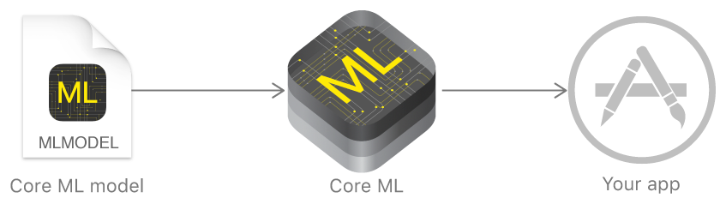
CoreML
With Core ML, we can integrate trained machine learning models into our app.
Core ML is the foundation for domain-specific frameworks and functionality

Slide 4
If your model is created and trained using a supported third-party machine learning tool, you can use Core ML Tools to convert it to the Core ML model format. The list of the supported models and third-party tools are in the next slide.
Note
Core ML Tools is a Python package (coremltools), hosted at the Python Package Index (PyPI).

Slide 5
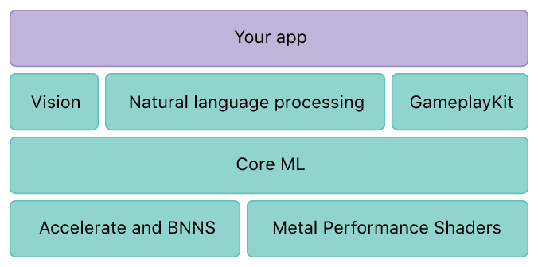
Core ML Layers
Core ML is a high level abstraction that is built on top of Accelerate, BNNS and MPSCNN
Accelerate and Basic Neural Network Subroutines (BNNS) – Efficiently utilize CPU for predictions using Convolutional Neural Networks.
Metal Performance Shaders CNN (MPSCNN) – Efficiently utilize GPU for predictions using Convolutional Neural Networks.

Slide 6
Core ML Supported Models
The following models are supported in Core ML
Deep Neural Networks
Recurrent Neural Networks
Convolutional Neural Networks
Support Vector Machines
Tree Ensembles
Linear Models

Slide 7
Importing models from Frameworks
Currently Core ML supports importing model from other frameworks. The following vendors are supported
Caffe
Scikit
LIBSVM
Keras
Python model conversion using coremltools
#!/usr/bin/env python3 import coremltools coreml_model = coremltools.converters.caffe.convert(‘caffe_model.caffemodel’)

Slide 8
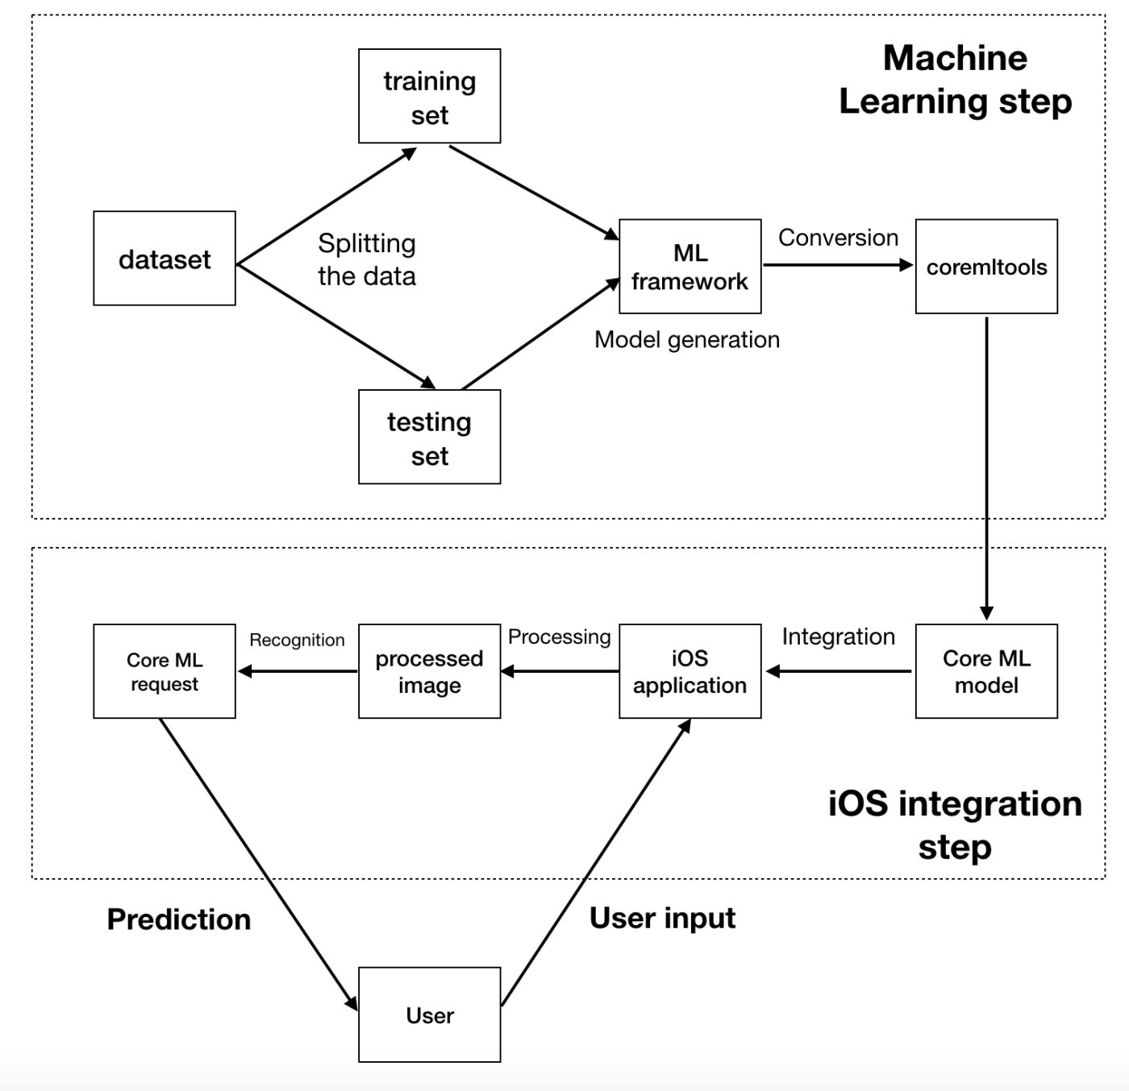
Text Recognition
Using Vision API and Core ML
The implementation consists of two steps
The selection and training of model is done. Then the model is created in a machine learning framework. It has to be converted to Apple’s Core ML format.
After we have the model, the second step is the iOS integration. Developers can easily integrate the Core ML model and focus on the app development.

Slide 9
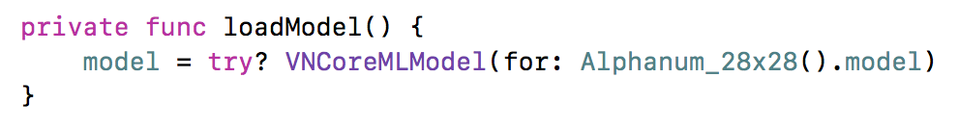
Image capture using Vision API
Using Vision we can easily use the camera interface and obtain grayscale frames from it.
Vision being native to iOS, we can easily integrate the two frameworks.
Here we are using the Alphanum_28x28 which is a trained Convolutional neural network model which has already been trained with numerous grayscale text images.

Slide 10
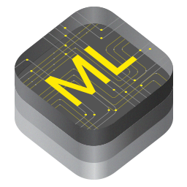
Pros
Cons
Optimized for on-device performance, which minimizes memory footprint and power consumption.
On-device means privacy of user data, you no longer need to send data to your servers to make predictions.
On-Device means functional predictions even without an internet connection and a less response time to the user.
It decides for itself whether to run the model on the CPU or the GPU (or both).
Because it can use CPU, you can run it on the iOS simulator (which doesn’t support GPU).
Native support for Supervised models only doesn’t have support for unsupervised or reinforcement learning.
No training on the device, only inference(prediction).
If CoreML does not support a certain layer type, you can’t use it. Currently impossible to extend Core ML with your own layer types.
Core ML conversion tools only support specific versions of a limited number of training tools.
You cannot look at the output produced by intermediate layers, you only get the prediction.

Slide 11
Implementation of our app
An aesthetic User Interface has been created for good user experience.
The UI has a browse button .
On clicking it, the app browses images from the gallery.
Using Core ML,the image has been segmented and the text has been recognized.
The inference of the Core ML is displayed in the UI.

Slide 12
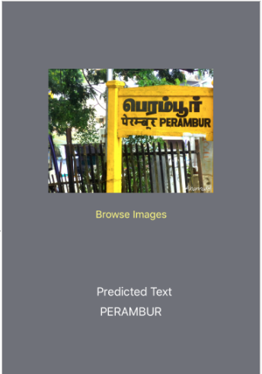
User Interface
The User Interface contains
ImageView - displaying the selected image
Label - showing the inference
Button - to browse for the images from PhotosTM
IMAGE TO BE PREDICTED
PREDICTED TEXT

Slide 13
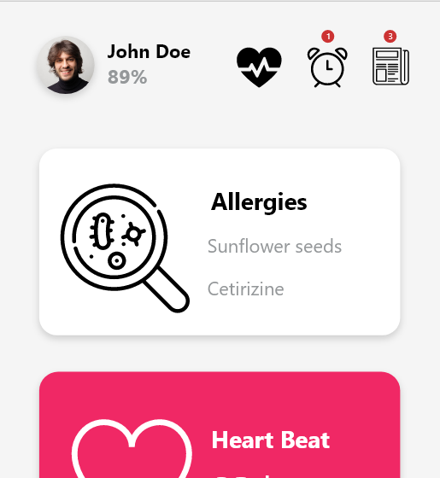

Integrating ML with Patient Health Care
Using Core ML in Patient Health Care App, we can predict and display the health of the user by showing the user a health percentage or health bar.
An attempt to gamify the process.
⚠ The image is concept art of the implementation

Slide 14
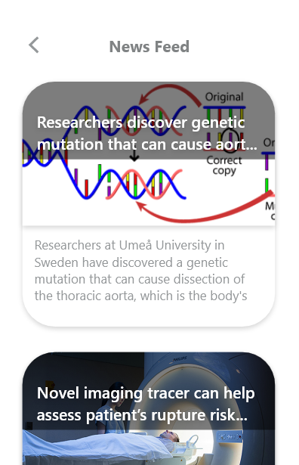
Personalized Feeds
By using Core ML , we eliminate the process of asking the user for their personal health records ,but instead predict patient’s health condition by certain factors such as health percentage, weight, allergies, etc.
Thus educating the user for what is required rather than what they think is required.
⚠ The image is concept art of the implementation

Slide 15
References
https://martinmitrevski.com/2017/10/19/text-recognition-using-vision-and-coreml/
https://en.m.wikipedia.org/wiki/Convolutional_neural_network
https://en.wikipedia.org/wiki/Gamification
https://developer.apple.com/documentation/coreml
https://developer.apple.com/documentation/coreml/converting_trained_models_to_core_ml

Slide 16
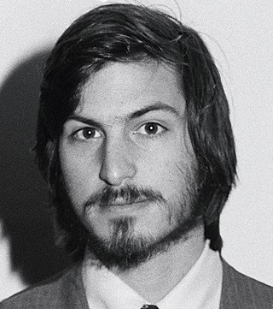
Thank you for watching!
“Our method was to develop integrated products, and that meant our process had to be integrated and collaborative”
Steve Jobs

